Slide 1
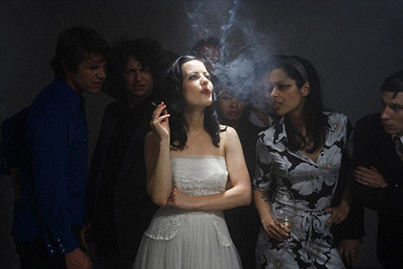
LUNG CANCER
Your Friends Did Not Choose to Smoke, So Don't Make Them Suffer Too
Secondhand smoke each year kills approximately 3,400 people and is a known human carcinogen. In the U.S., adults exposed to secondhand smoke often lose an average of 13.2 to 14.5 years of life.
Each time you smoke around those you love, your increasing their chances of developing lung cancer.
Stop Harming Others:
Avoid smoking around your classmates
Do not smoke inside campus buildings where people cant avoid inhaling smoke
Stop lingering and smoking around doorways
Think about others before you light a cigarette
Source: American Lung Association http://www.lung.org
For more information visit: http://eanmilligan.wix.com/cancer-intervention or scan the QR code.
Created by: Brittany Lawson, Ean Milligan, and Makayla Day

